Slide 1



ASSIGNMENT ( 4 ) [ Advanced ]
Arrays Assignment
Grade : 100 Point
Deadline : 25/10/2023 – 11:59PM

Slide 2
Question One [15 point]
Read an Integer N, then read N integers. { N : Length of array }
Print the array after replace each minimum number with maximum number
Input
4 1 2 3 4
Output
4 2 3 1
Input
5 -1 2 3 5 -1
Output
5 2 3 -1 5
Input
7 4 1 3 10 8 10 10
Output
4 10 3 1 8 1 1

Slide 3
Question Two [15 point]
Read an Integer N, then read N integers.
Print YES if array reads the same backward and forward , Otherwise Print NO.
Input
4 1 2 3 4
Output
NO
Input
5 1 3 2 3 1
Output
YES
Input
3 1 0 1
Output
YES

Slide 4
Question Three [15 point]
Read an Integer N, then read N integers.
Print the smallest possible result of A[i] + A[j] + j – i
Input
4 20 1 9 4
Output
7
Input
5 3 1 2 4 6
Output
4
Input
3 8 6 2
Output
9

Slide 5
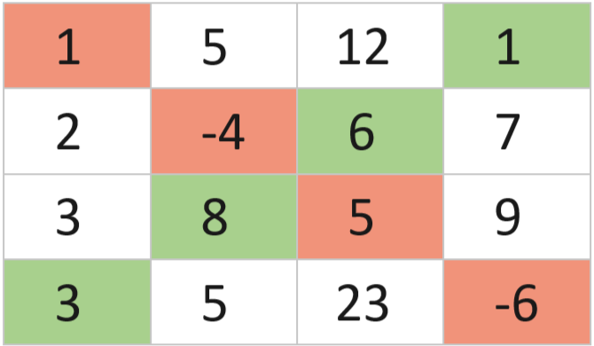
Question Four [15 point]
Given a number N and a 2D array A of size N * N.
Primary
Secondary
Print the difference between the summation of its two diagonals
(primary diagonal and secondary diagonal).
Input
4 1 5 12 1 2 -4 6 7 3 8 5 9 3 5 23 -6
Output
-22
Sum_primary = 1 + (-4) + 5 + (-6) = -4
Sum_secondary = 1 + 6 + 8 + 3 = 18
Answer = -4 – 18 = -22

Slide 6
Question Five [20 point]
Read an Integer N, then read N integers and an integer k .
Print the maximum summation achievable by selecting at most k elements from the array.
Input
2 2 1 2
Output
3
Input
6 3 5 2 4 8 9 1
Output
22
Input
5 2 -25 -16 -9 0 -3
Output
0

Slide 7
Question Six [20 point]
Read an Integer N, then read N integers.
Array is called ALT array if each element has a different sign than the one next to it.
Print the minimum number of operations required to convert the given array into an ALT array. You are allowed to choose a number and change its sign ( operation++ ).
Input
3 3 4 2
Output
1
Input
5 1 -2 3 -4 5
Output
0
Input
20 4 -12 -10 14 -15 19 12 4 -7 14 -3 -16 6 -4 9 18 -8 10 6 -17
Output
9

